Slide 1



Project
Tento
Latin word for “I try”
A free online evaluation platform for Cambridge students

Slide 2
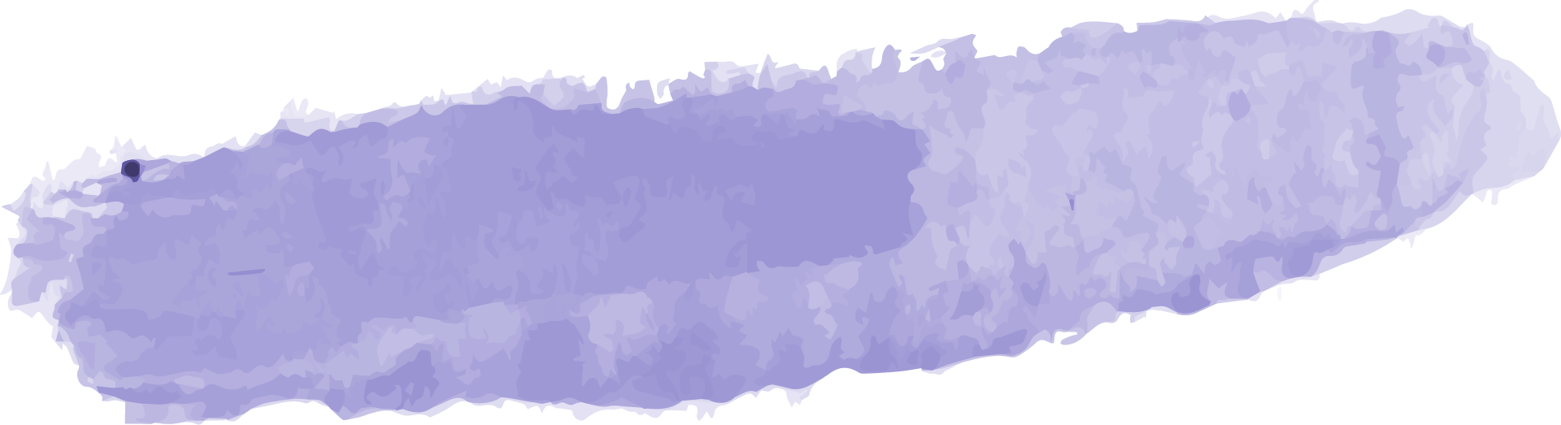

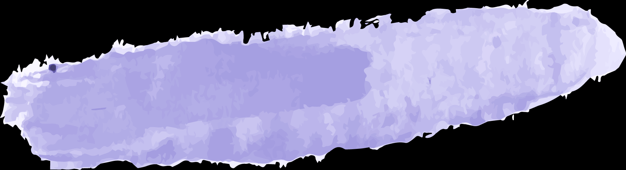
Our Team
Nafisa Maliyat
Kazi Jawadul Islam Jishan
Shanta Maria
200042133
200042165
200042172

Slide 3


Table of Contents
01
02
03
Project
Overview
Database
ERD
Implemented
Features
04
05
Challenges
Timeline
06
Demo

Slide 4
01
Project Overview

Slide 5
Online Educational Website
Free to use
Targeted audience: O and A level candidates
Evaluation using MCQs
Topics from the entire Cambridge syllabus
Vast range of subjects

Slide 6
02
Database ERD

Slide 7
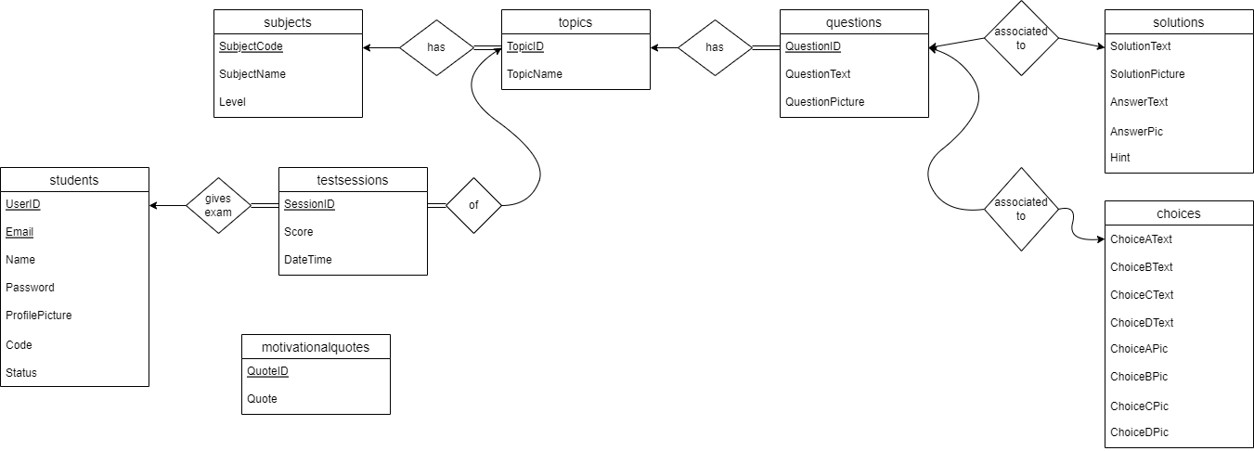
Database ERD

Slide 8
03
Implemented Features

Slide 9

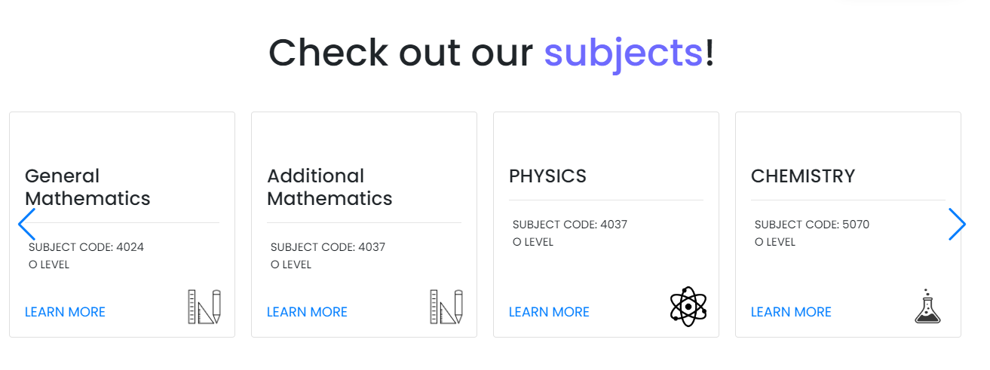
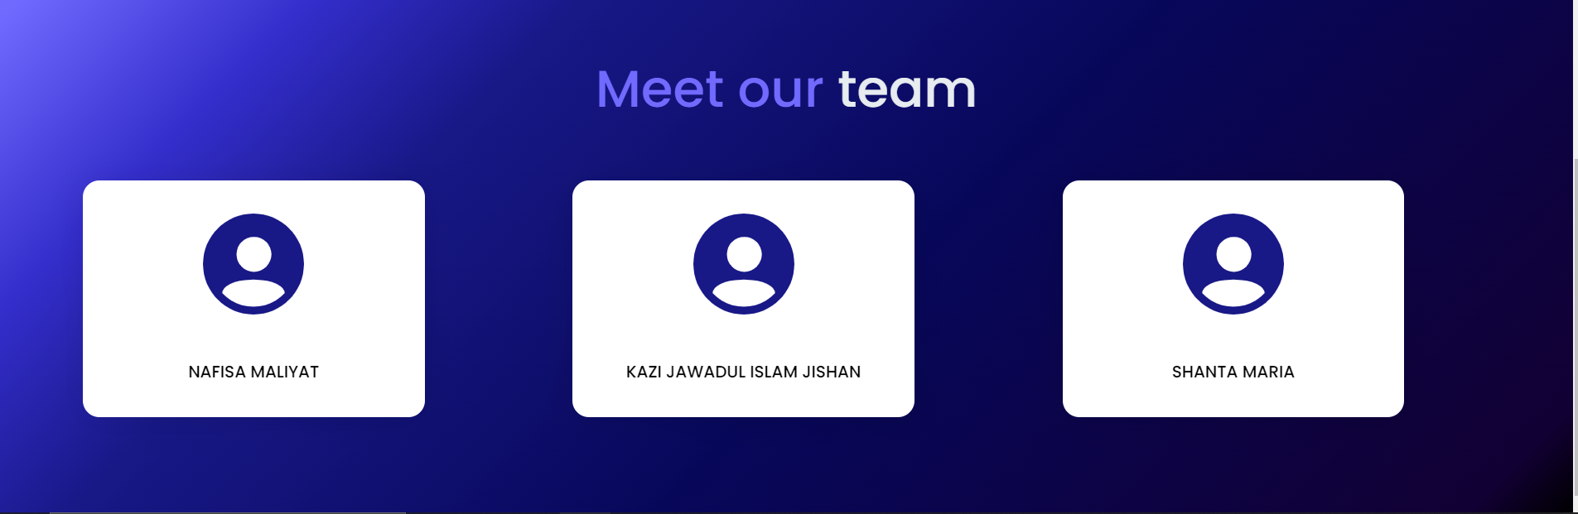
OUR
LANDING PAGE

Slide 10
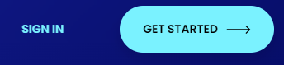
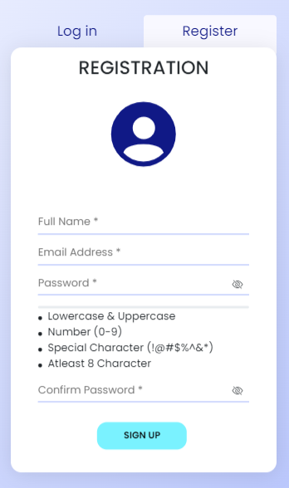
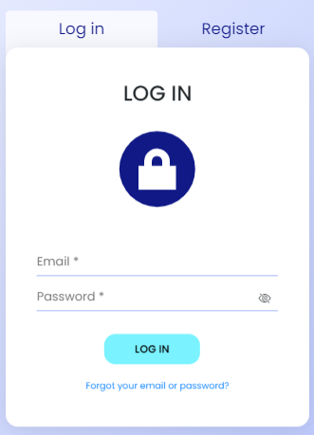

Slide 11
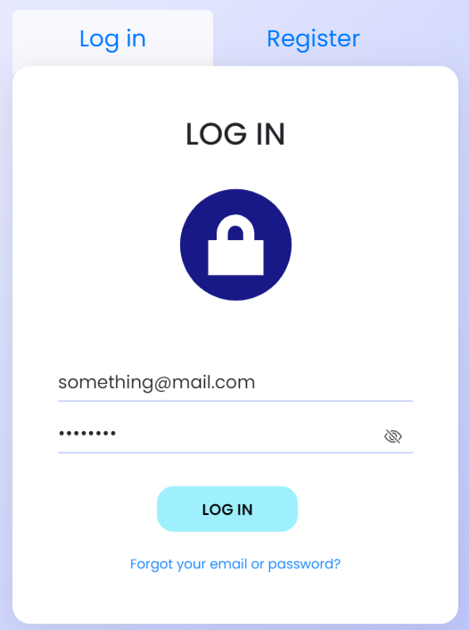
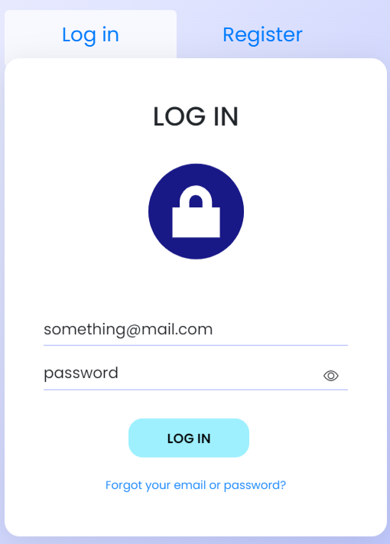

Slide 12
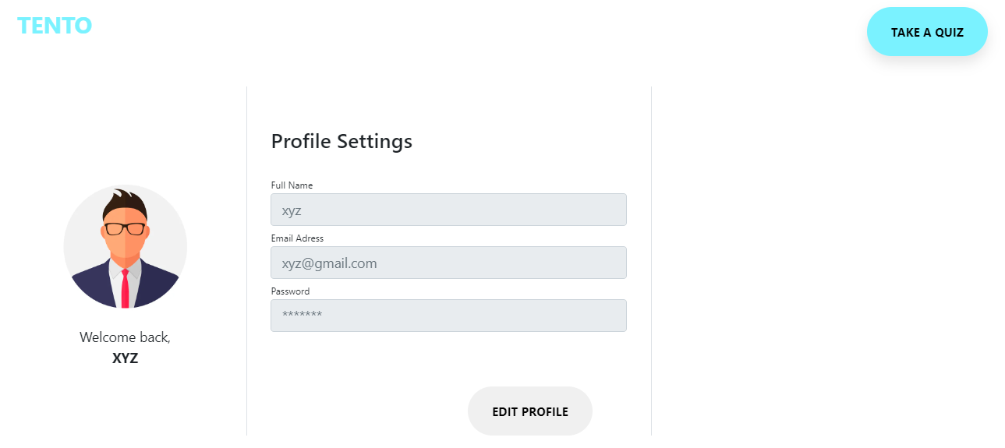

Slide 13
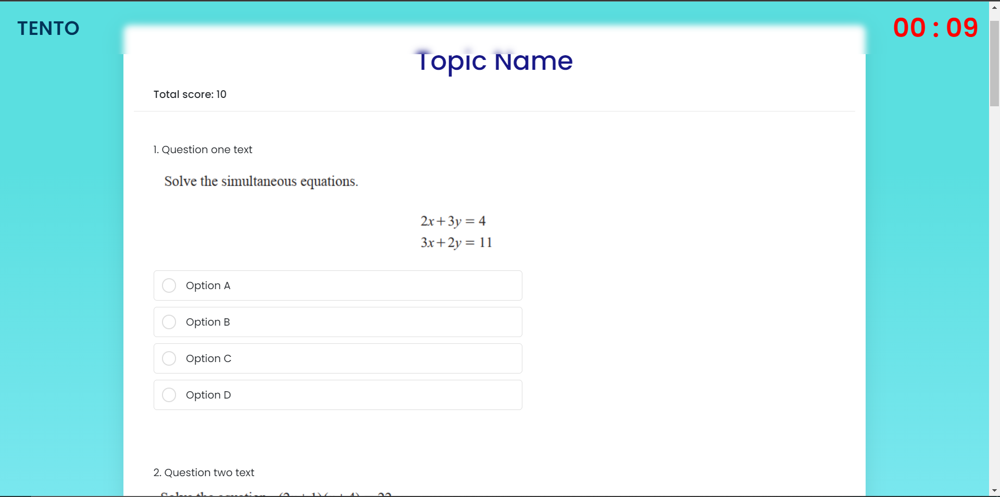

Slide 14
04
Challenges

Slide 15




Challenges
01
Project Planning
Planning all the details of the project
02
Following the Timeline
Difficulty in estimating each feature implementation time
03
Code Bugs
Difficulty in finding and solving bugs
04
Time and Technology
Too much time spent on finding resources

Slide 16
05
Timeline

Slide 17
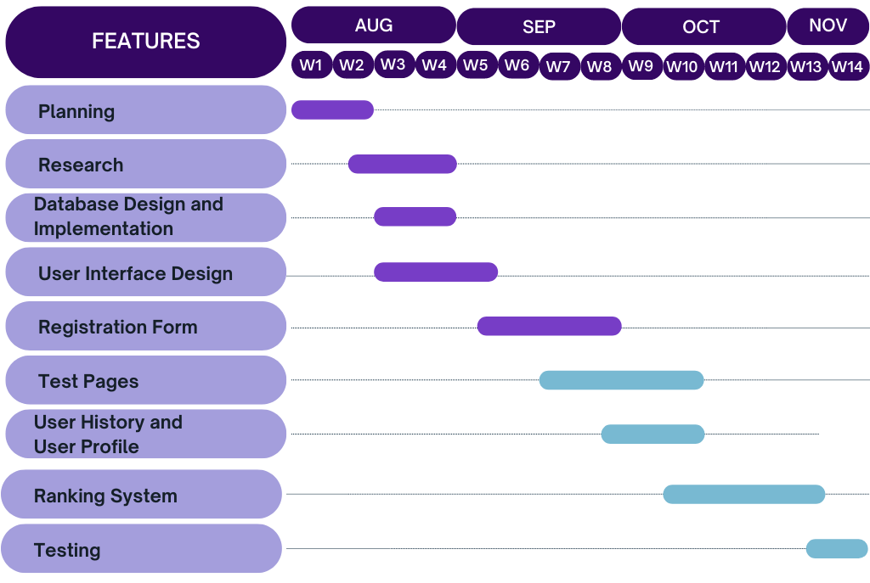
Where we are now

Slide 18
06
Demo

Slide 19
Thank you for listening. Any suggestions would be welcomed

